Slide 1

Institute for Advanced Computing and Software Development, Pune
Academic Year 2020-21
Project on
“Diet Management System”
E-DAC SEPT 2020
Submitted By:
Group No: 55
Aaditi Mane - 2093
Mansi Patil - 2096
Prashant Karhale Mr. Milind Arjun
Centre Coordinator Project Guide

Slide 2
CONTENTS
Introduction
Purpose
Scope
Features
Requirements
Project description
Data flow diagrams
Entity Relationship Diagram
Use Case Diagrams
Activity Diagrams
Database tables
Screenshots
Conclusion

Slide 3
Introduction
Dietary management is important for personal health. However, it is challenging to record quantified food information in an efficient, accurate, and sustainable manner.
Busy lives affect changes in eating habits. Due to increase in bad eating habbits of population, the public tends to be on high-fat diet, low-fiber foods, lack of exercise plus static lifestyle, which results in obesity and nutritional imbalance.
Proper diet and moderate exercise are the only way to maintain good health. However, people often are not very concerned with diet control, and it causes some health problems.
The effective ways to remain healthy is by controlling diet and doing exercise. Healthy diet is the healthy eating habit. A good diet is the well-balanced food intake that fulfills all the body's need.

Slide 4
Purpose
A system through which dietitians can generate the proper dietary menu for the patients and also can maintain and manage the data of patients.
It also facilitates dietician to give diet as per patient physiological conditions. Monitoring of patient diet is the primary function of the Diet Management System.

Slide 5
Scope
Our Diet Management System mainly focuses on generating the proper dietary menu for the patients and also maintaining and managing the data of patients.
Our system is aimed to be used by dietitians and focuses on building the system for single doctor.

Slide 6
Features
This Diet Management System solution is fully functional and flexible.
It is very easy to use.
Saves time needed for manual processing.
Eco-friendly: The monitoring of the Diet Management System becomes easy and includes the least of paper work.
The application acts as an office that is open 24/7.
Immediate retrieval and storage of information.
Planned approach towards working.
It increases the efficiency of the management at offering quality services to the doctors as well as the patients.

Slide 7
Requirements
Software Requirement
Operating System: Windows 10
Front end: React Js
Back end: Spring boot
Database: MySQL
Hardware Requirements
Processor: I3 or higher
RAM: 4GB and above

Slide 8
Project Description
Users and Characteristics
Admin/Doctor:
Admin/Doctor can login to the system.
Can view appointment list scheduled.
Consultation for registered patient.
Consultation for new patient.
Assign the predefined diet plans to patients.
Assign the new diet plans to patients.
Can view, create and edit the diet plans.
Can view ,add and edit patient details.
Can create multiple users and also can edit.
Will sent the diet plans via mail.

Slide 9
Receptionist:
Receptionist can login to the system.
Can view patient appointment list.
Can add the appointment for patient.
Can add new patient.
Can create case paper.
Can view the receipt generated.
Patient:
Can get the information like payment receipt, appointment details through system.
Can get the information like consultation date and diet plan details through mail.

Slide 10
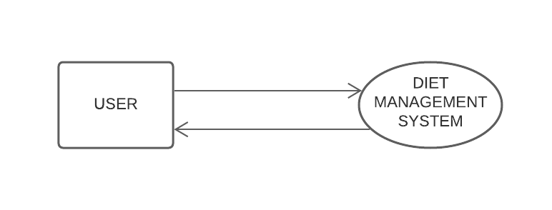
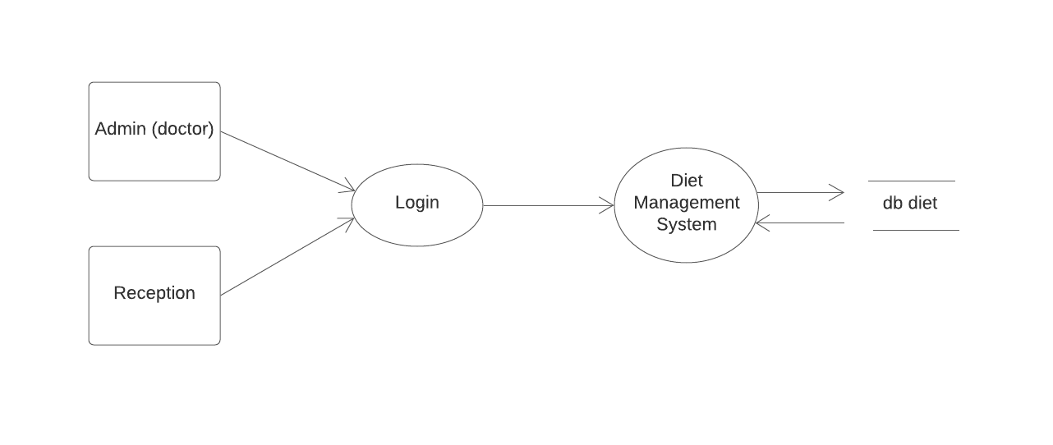
Data flow diagram
Figure: Level 0 data flow diagram
Figure: Level 1 data flow diagram

Slide 11
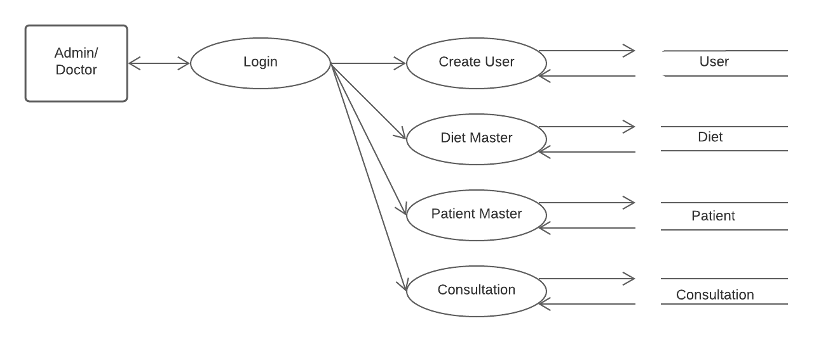
Figure: Level 2 data flow diagram for Admin

Slide 12
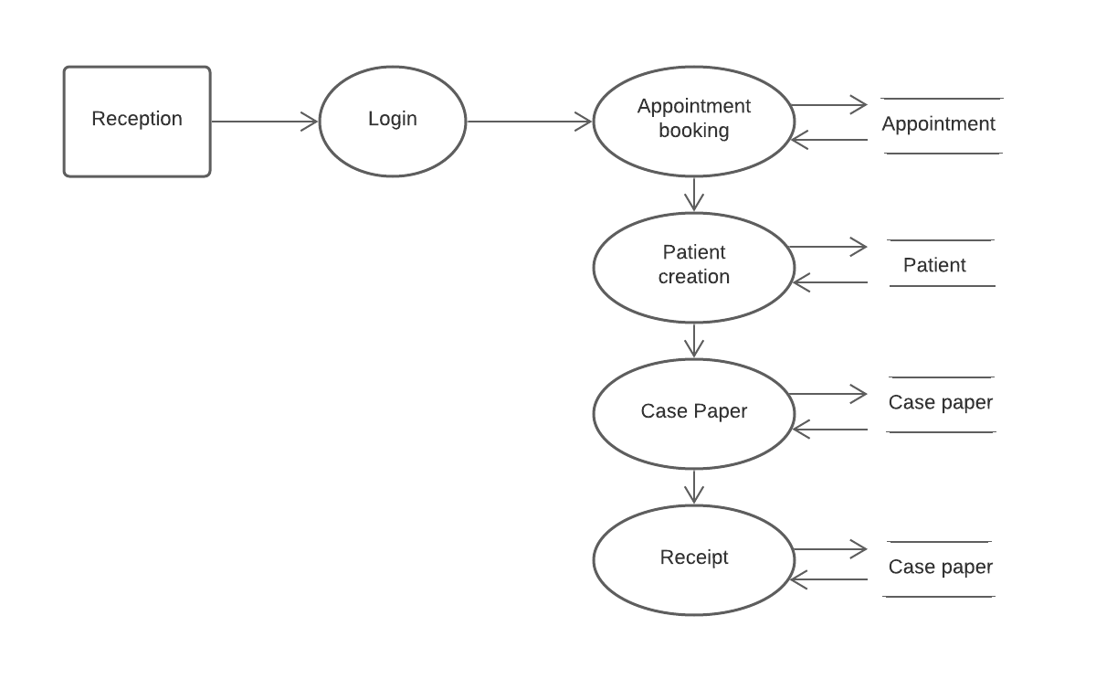
Figure: Level 2 data flow diagram for Receptionist

Slide 13
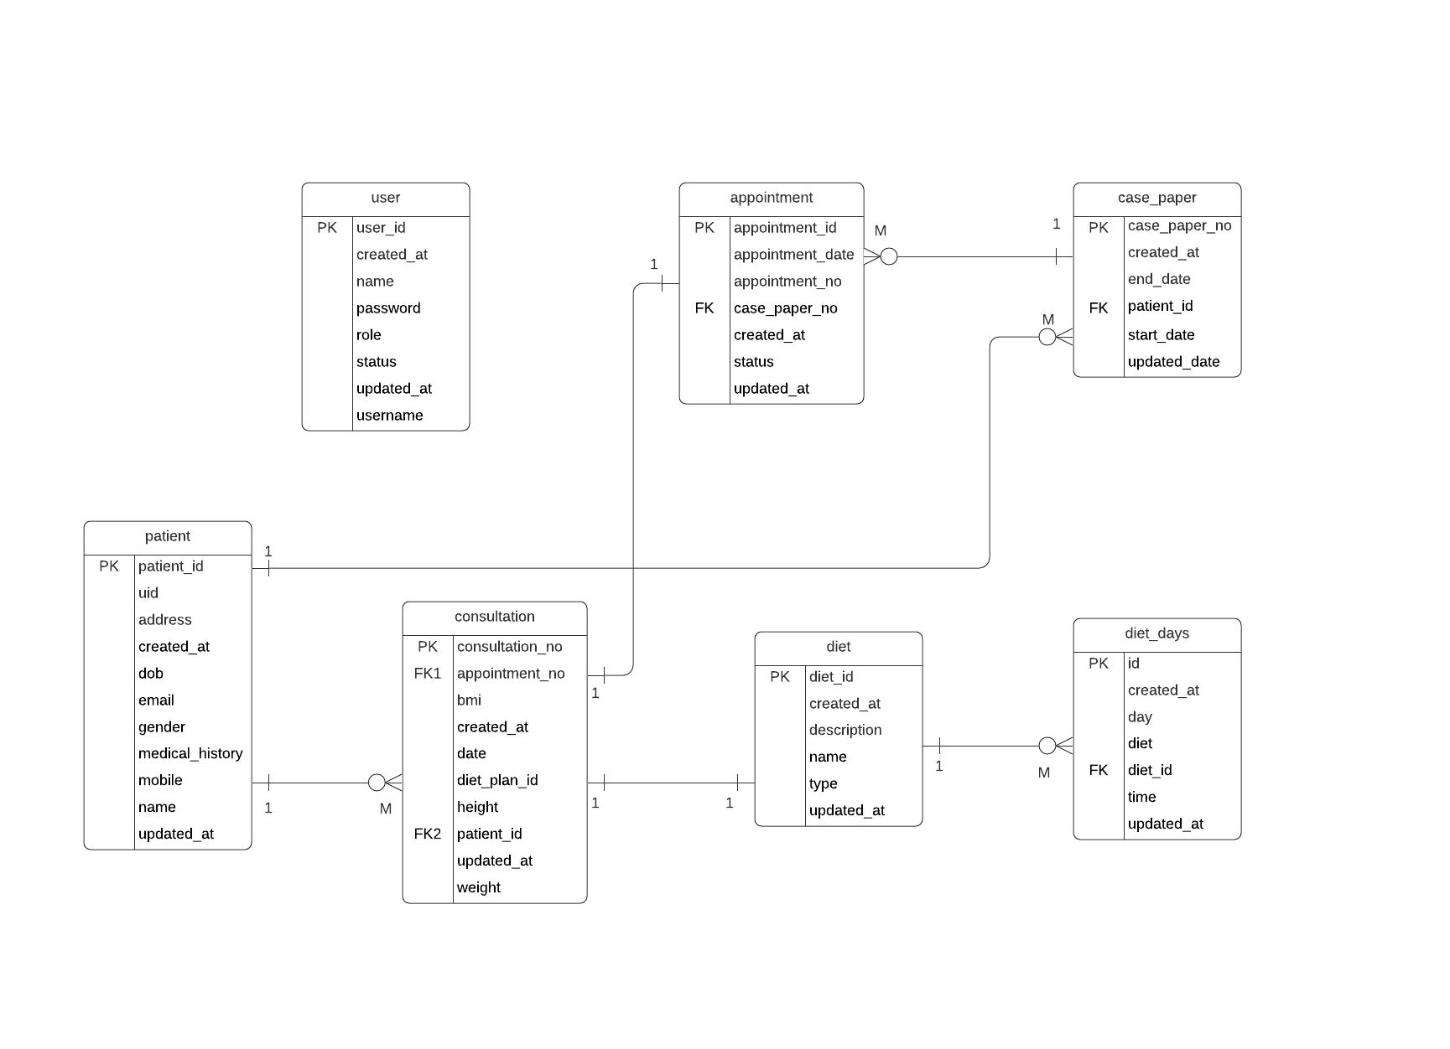
ER diagram

Slide 14
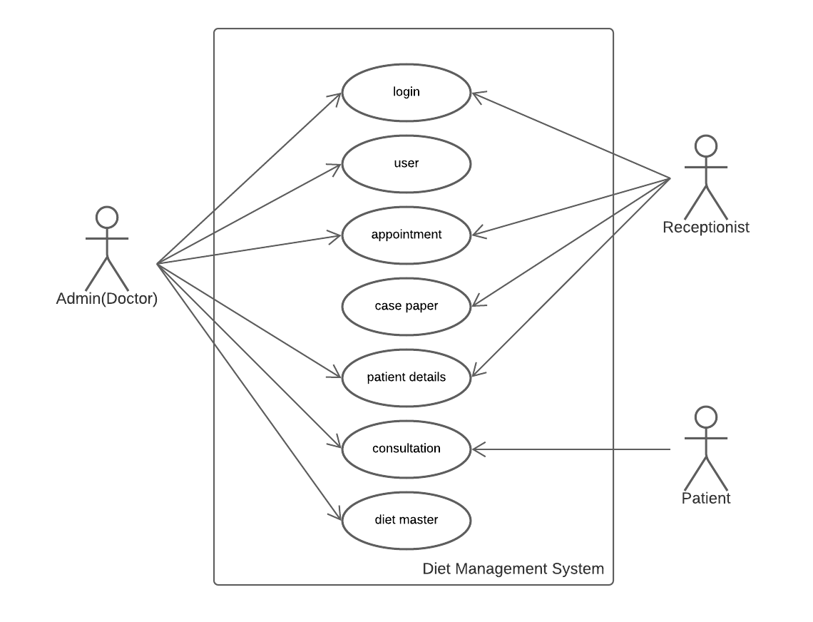
Use Case Diagram

Slide 15
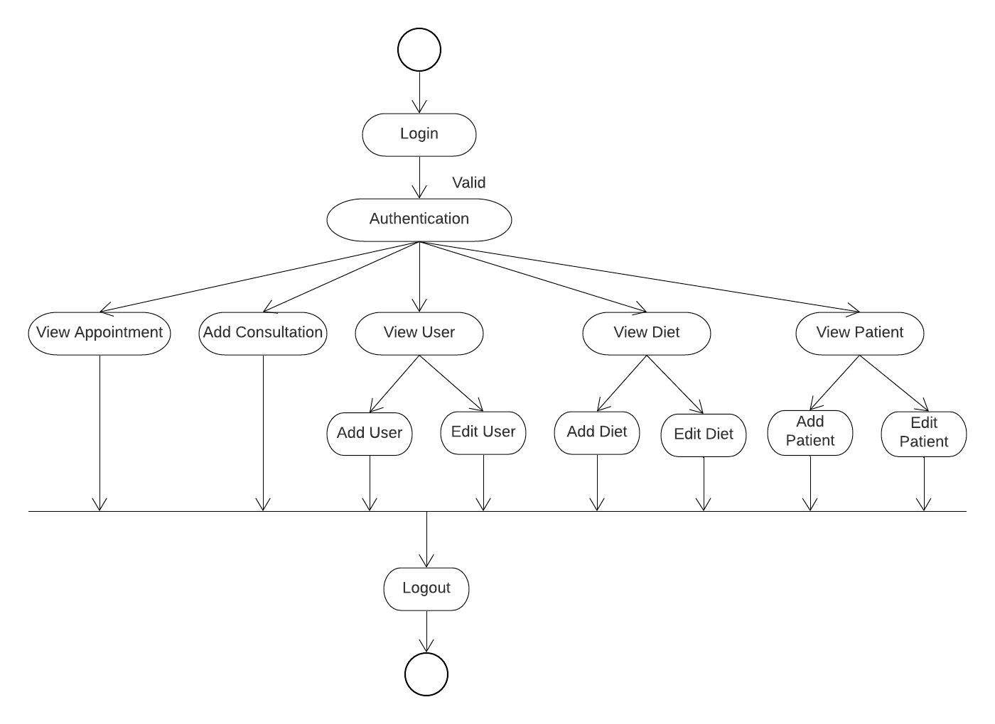
Activity Diagram
Figure: Activity diagram for Admin

Slide 16
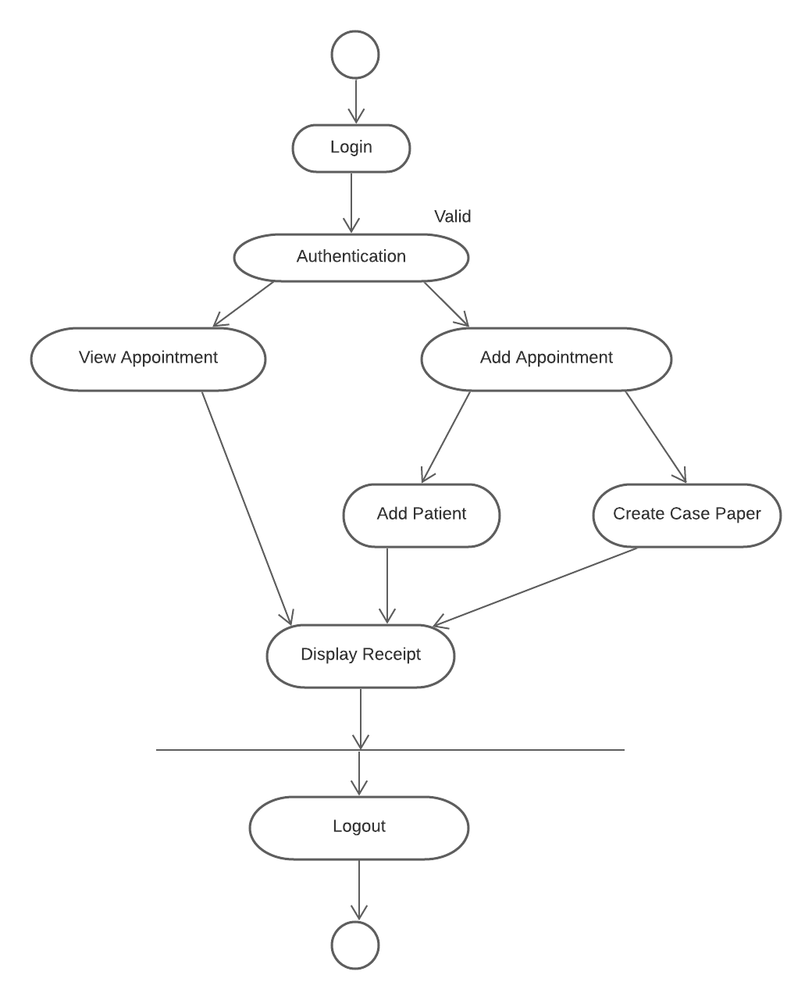
Figure: Activity diagram for Receptionist

Slide 17
Table Structures
users:
Field | Type | Null | Key | Default | Extra
user_id | int | NO | PRI | NULL | auto_increment
created_at | datetime | YES |  | NULL
name | varchar(255) | YES |  | NULL
password | varchar(255) | YES |  | NULL
role | varchar(255) | YES |  | NULL
status | varchar(255) | YES |  | NULL
updated_at | datetime | YES |  | NULL
username | varchar(255) | YES |  | NULL

Slide 18
appointment:
case_paper:
Field | Type | Null | Key | Default | Extra
appointment_id | int | NO | PRI | NULL | auto_increment
appointment_date | date | YES |  | NULL
appointment_no | int | NO |  | NULL
case_paper_no | int | NO |  | NULL
created_at | datetime | YES |  | NULL
status | varchar(255) | YES |  | NULL
updated_at | datetime | YES |  | NULL
Field | Type | Null | Key | Default | Extra
case_paper_no | int | NO | PRI | NULL | auto_increment
amount | double | NO |  | NULL
created_at | datetime | YES |  | NULL
end_date | date | YES |  | NULL
patient_id | int | NO |  | NULL
start_date | date | YES |  | NULL
updated_at | datetime | YES |  | NULL

Slide 19
consultation:
diet:
Field | Type | Null | Key | Default | Extra
consulation_no | int | NO | PRI | NULL | auto_increment
appointment_no | int | NO |  | NULL
bmi | double | NO |  | NULL
created_at | datetime | YES |  | NULL
date | date | YES |  | NULL
diet_plan_id | int | NO |  | NULL
height | double | NO |  | NULL
patient_id | int | NO |  | NULL
updated_at | datetime | YES |  | NULL
weight | double | NO |  | NULL
Field | Type | Null | Key | Default | Extra
diet_id | int | NO | PRI | NULL
created_at | datetime | YES |  | NULL
description | varchar(255) | YES |  | NULL
name | varchar(255) | YES |  | NULL
status | varchar(255) | YES |  | NULL
type | varchar(255) | YES |  | NULL
updated_at | datetime | YES |  | NULL

Slide 20
diet_days:
patients:
Field | Type | Null | Key | Default | Extra
id | int | NO | PRI | NULL
created_at | datetime | YES |  | NULL
day | int | NO |  | NULL
diet | varchar(255) | YES |  | NULL
diet_id | int | NO |  | NULL
time | varchar(255) | YES |  | NULL
updated_at | datetime | YES |  | NULL
Field | Type | Null | Key | Default | Extra
patient_id | bigint | NO | PRI | NULL
uid | bigint | NO |  | NULL
address | varchar(255) | YES |  | NULL
created_at | datetime | YES |  | NULL
dob | date | YES |  | NULL
email | varchar(255) | YES |  | NULL
gender | varchar(255) | YES |  | NULL
medical_history | varchar(255) | YES |  | NULL
mobile | varchar(255) | YES |  | NULL
name | varchar(255) | YES |  | NULL
updated_at | datetime | YES |  | NULL

Slide 21
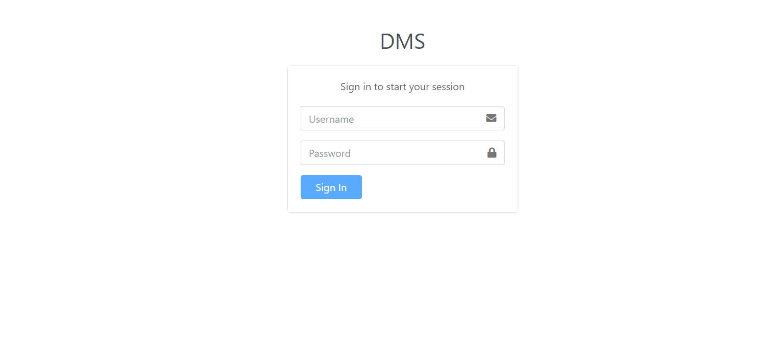
Screenshots Login Page

Slide 22
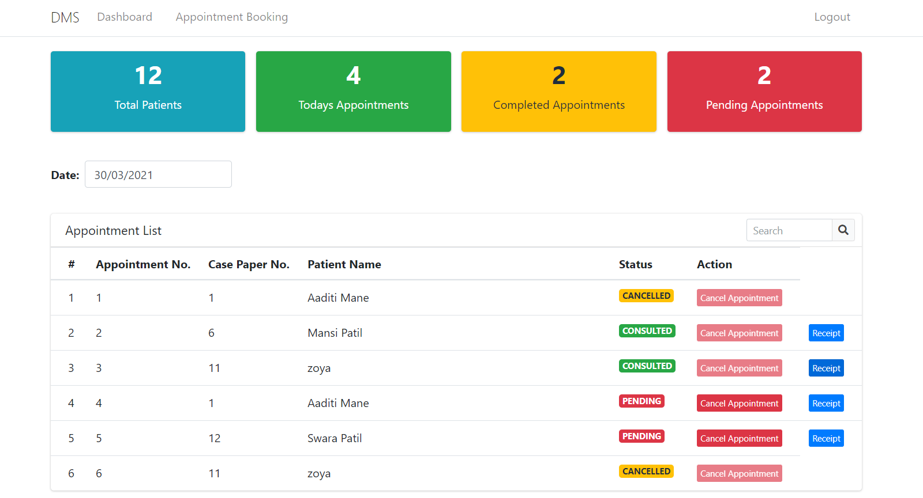
Appointment List

Slide 23
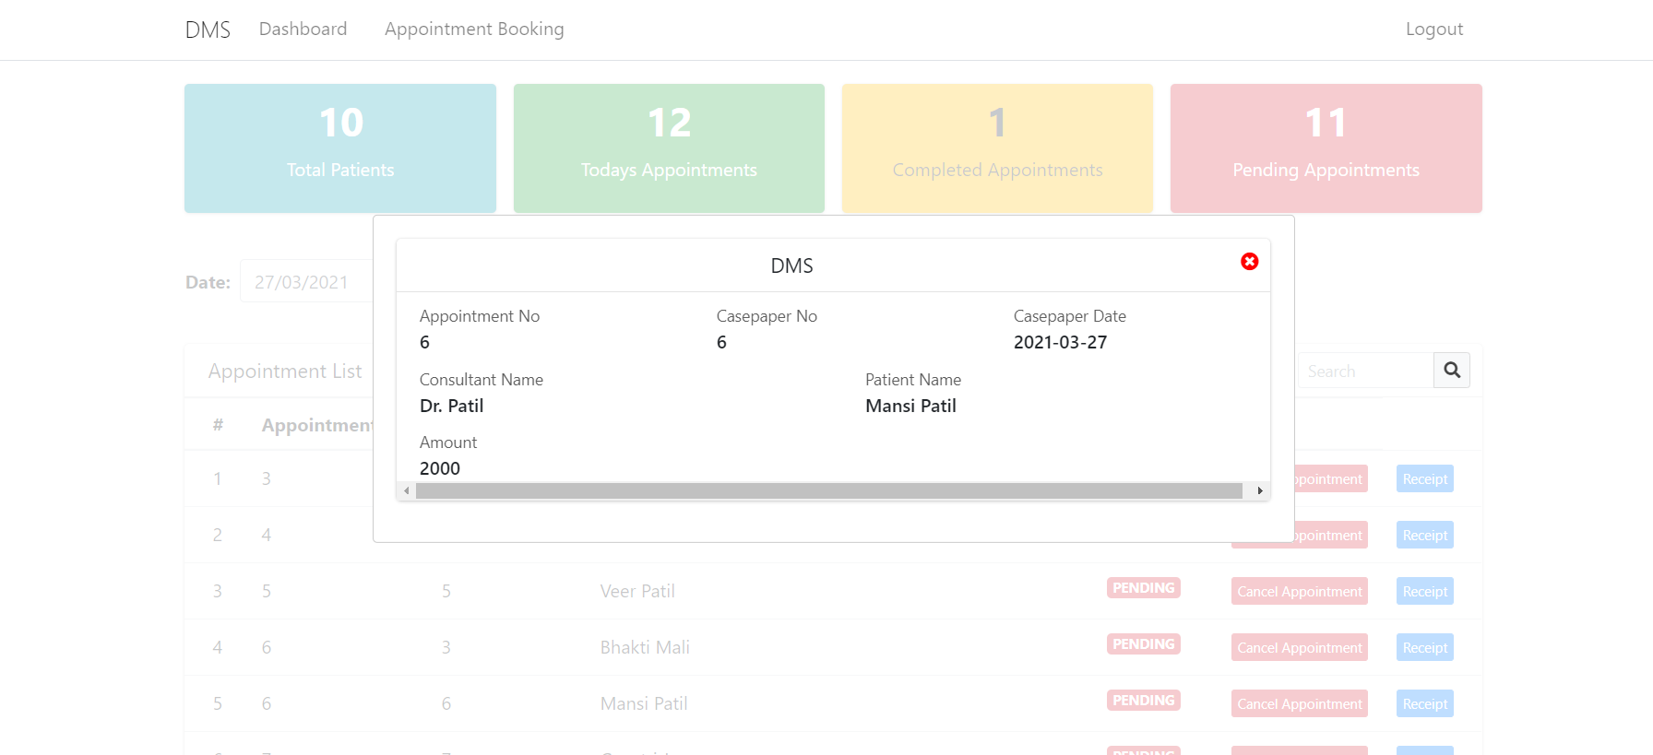
Payment Receipt

Slide 24
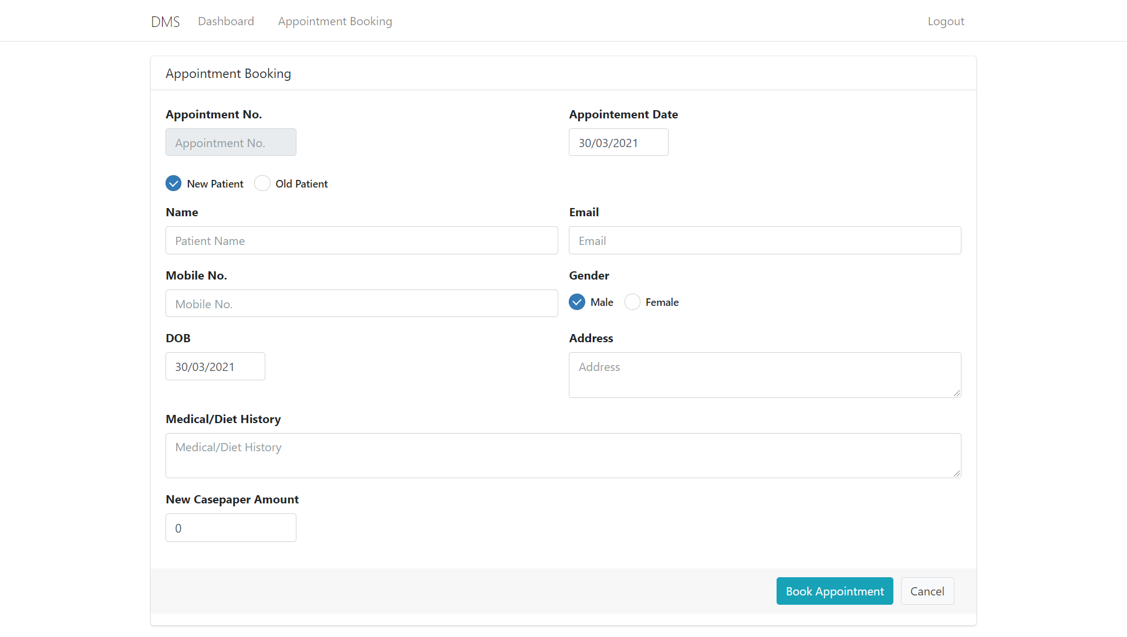
Appointment Booking for new Patient

Slide 25
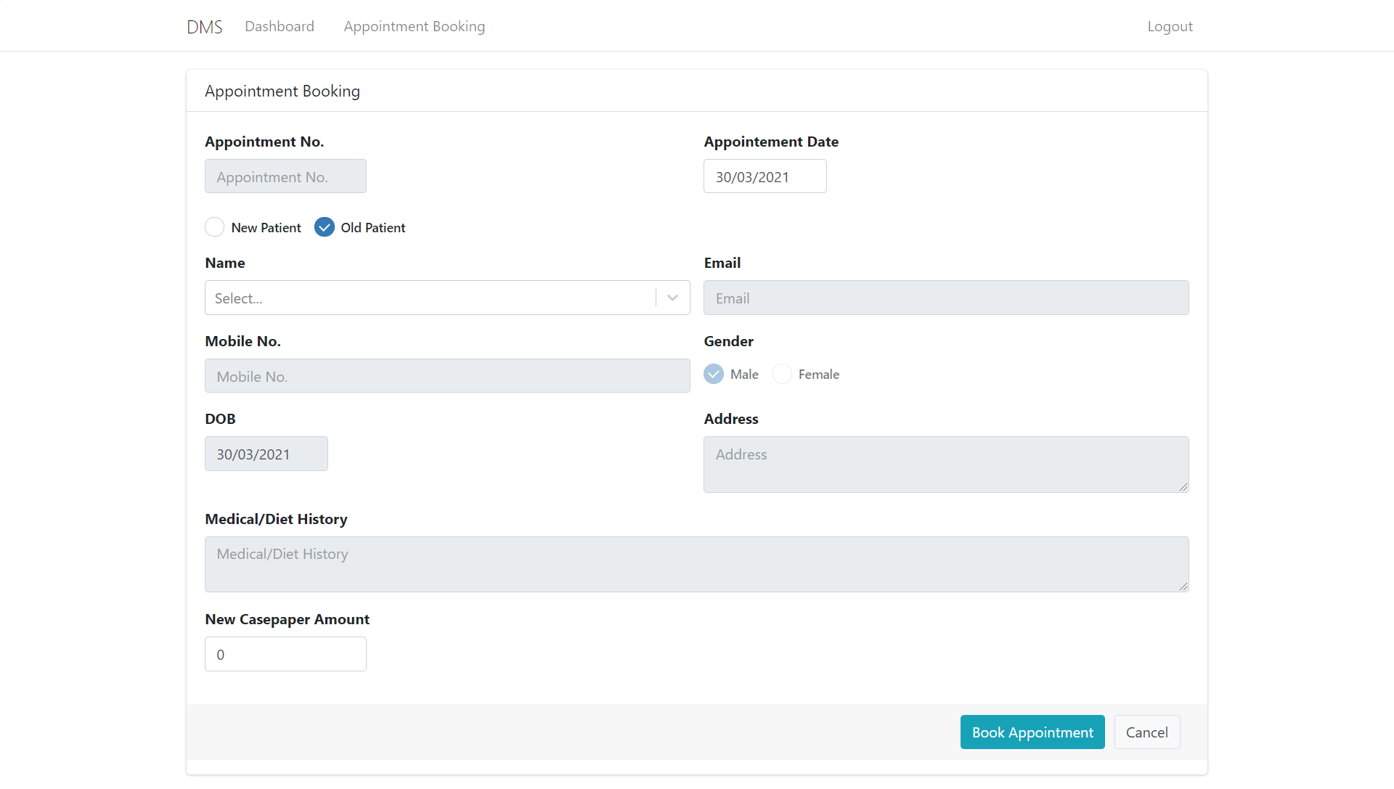
Appointment Booking for Old Patient

Slide 26
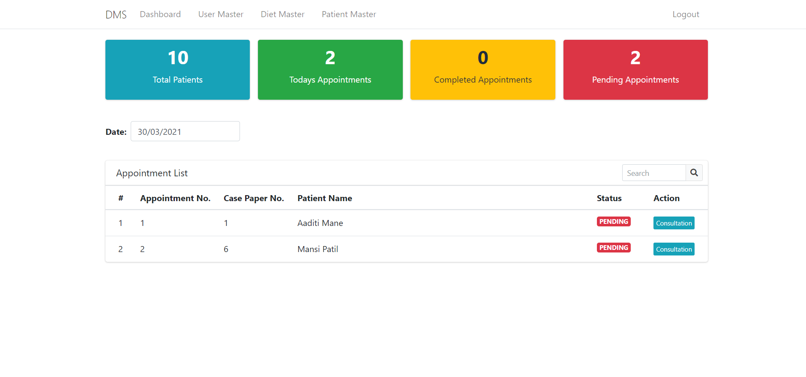
Appointment List in Admin Login

Slide 27
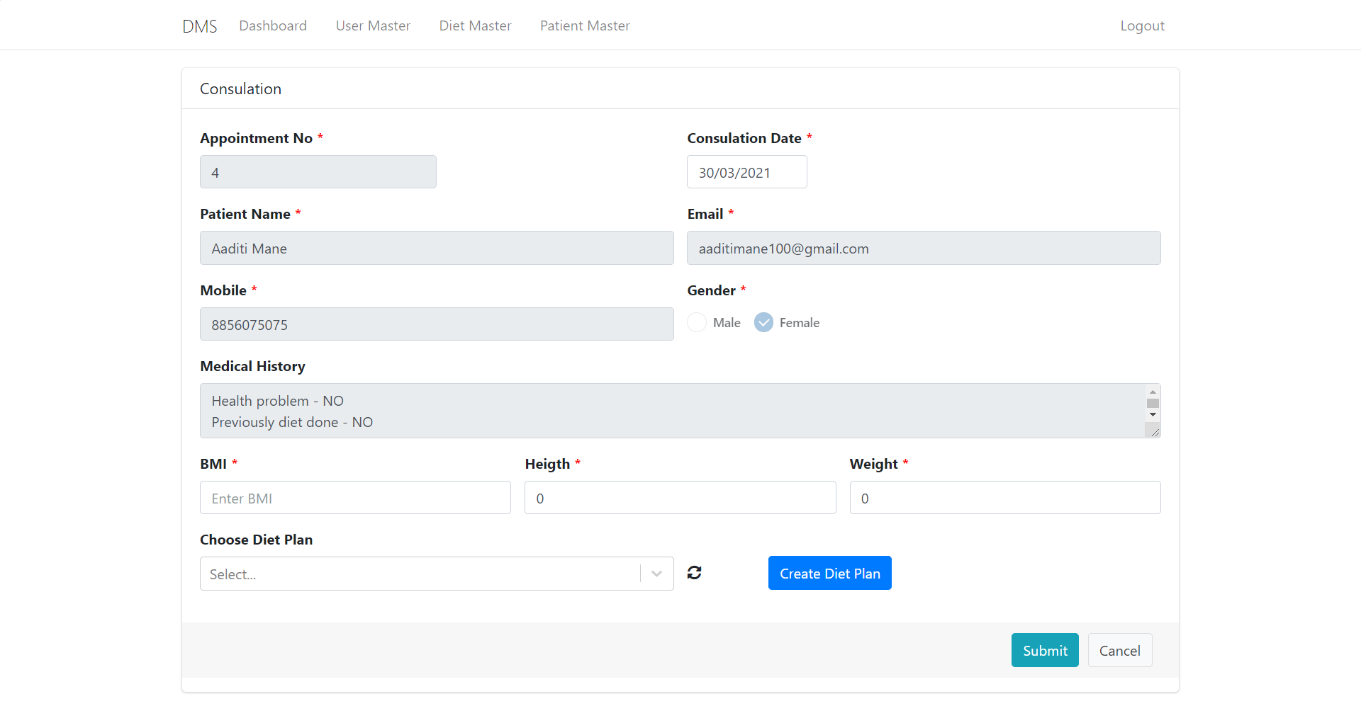
Consultation

Slide 28
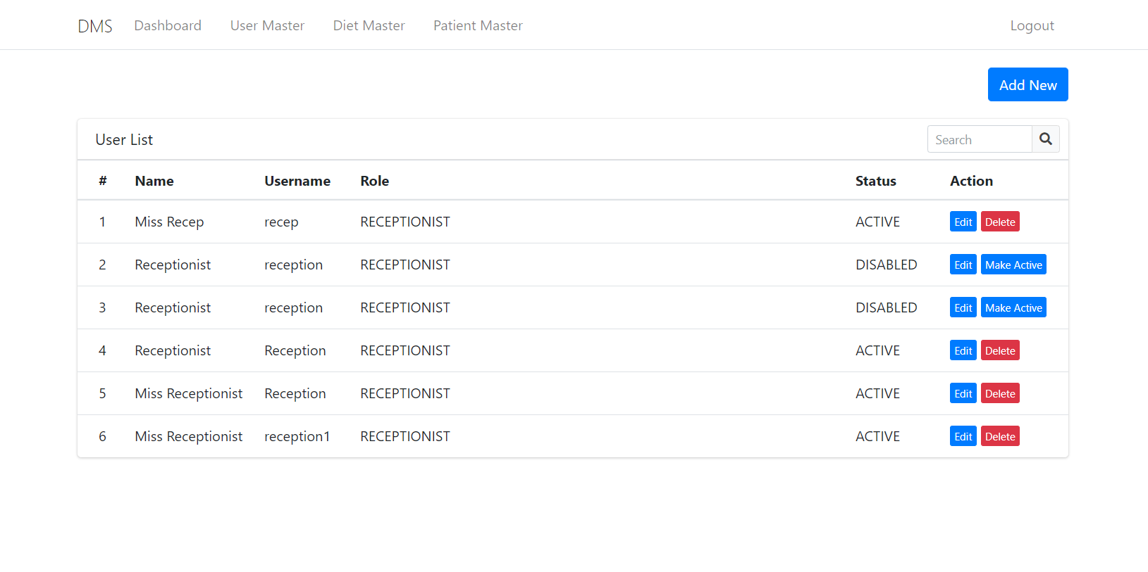
User List in admin login

Slide 29
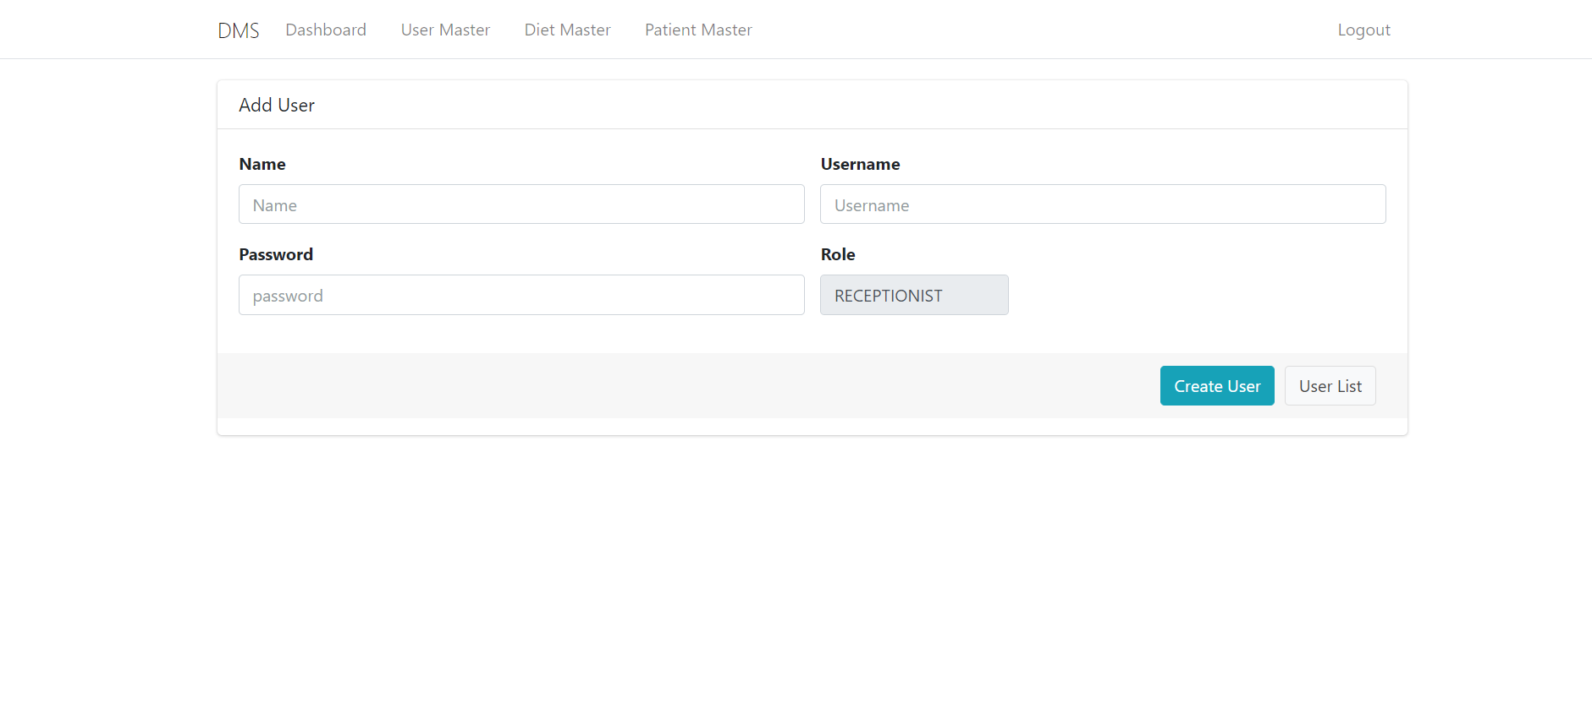
Add User in Admin login

Slide 30
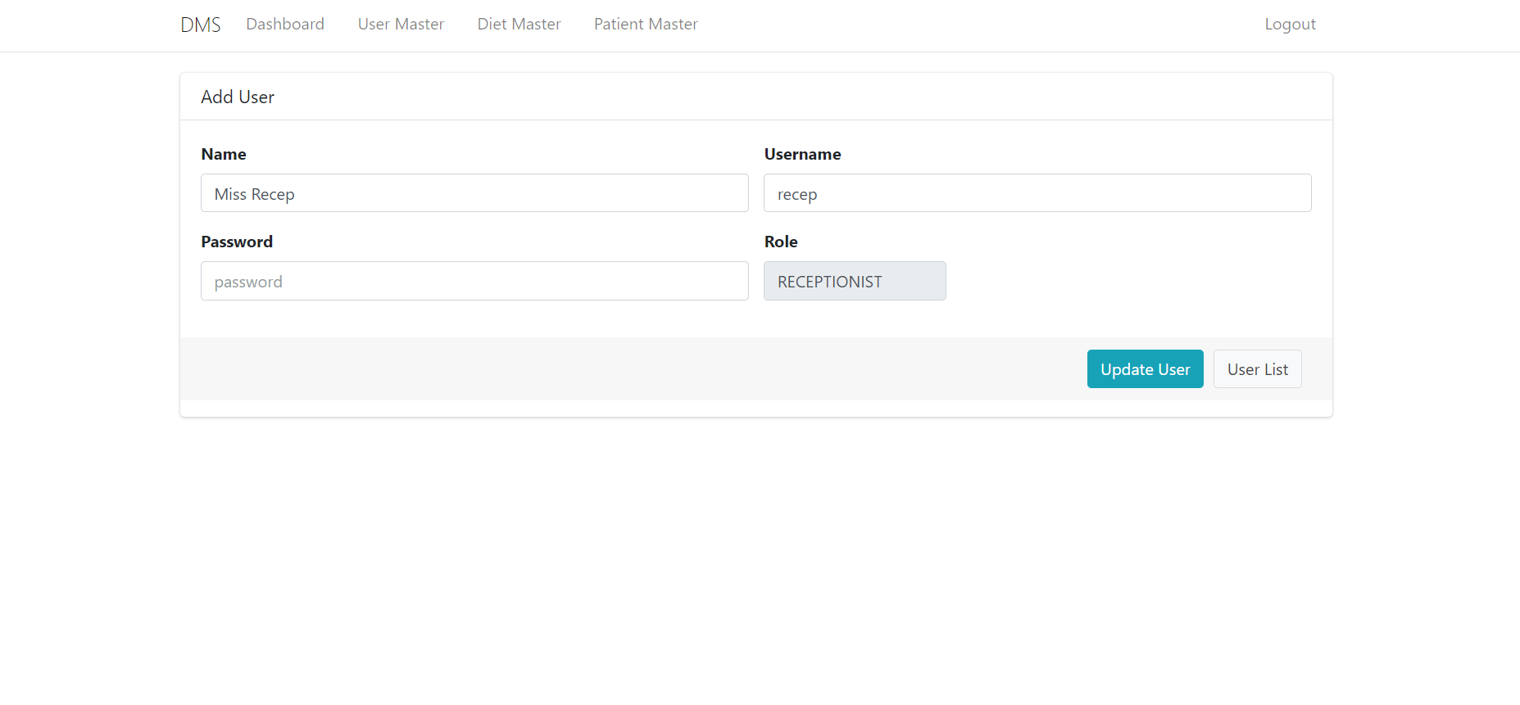
Edit User in Admin Login

Slide 31
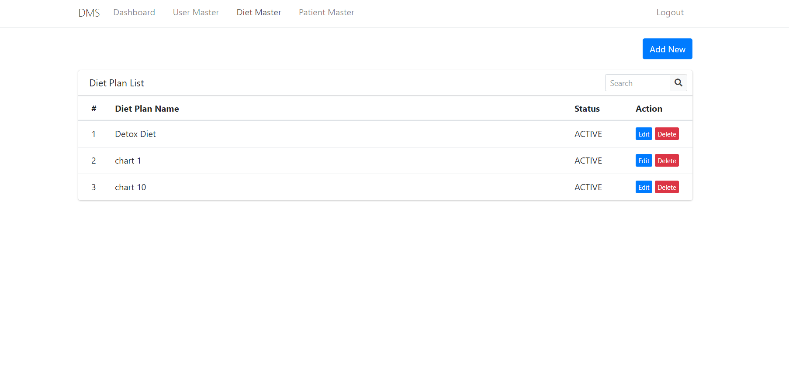
Diet Plan List in Admin login

Slide 32
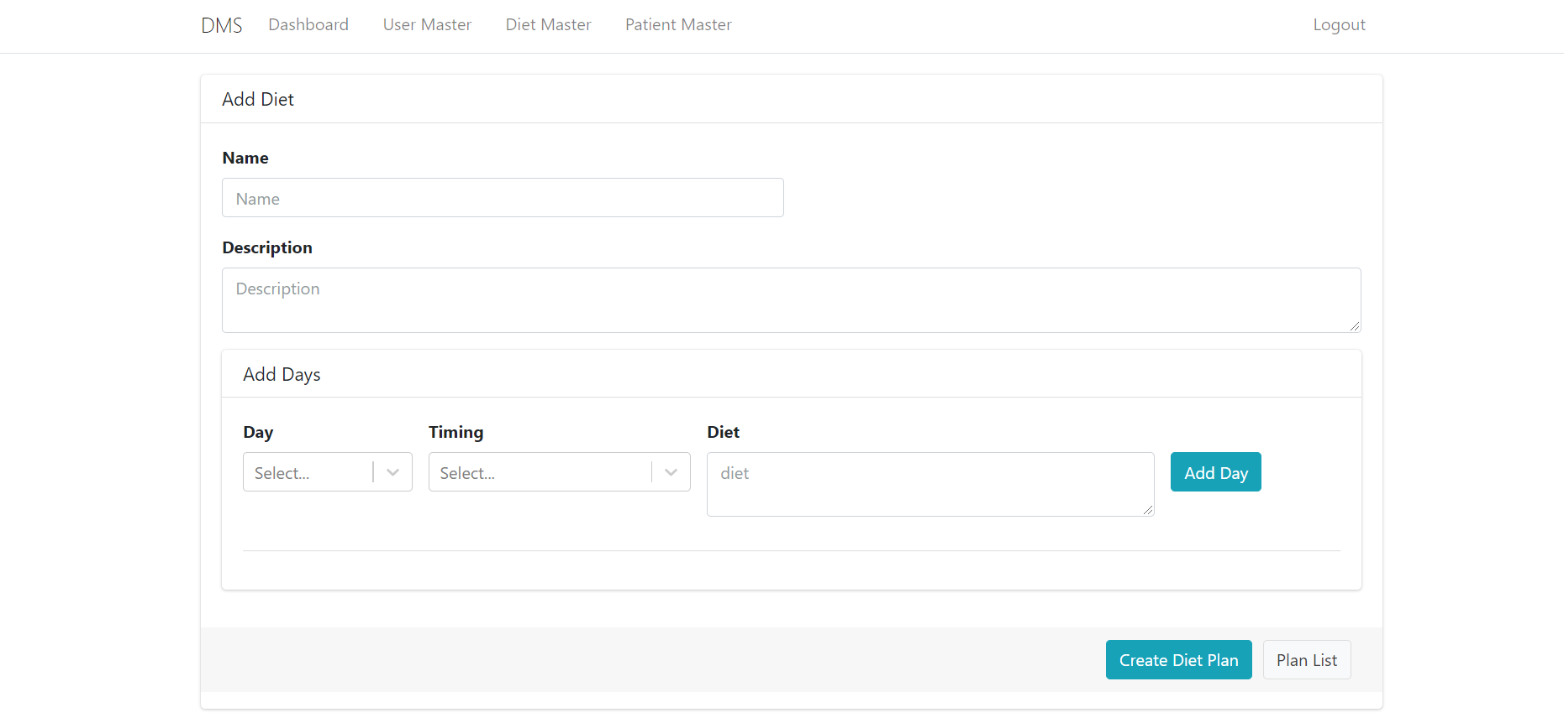
Add Diet Plan in Admin login

Slide 33
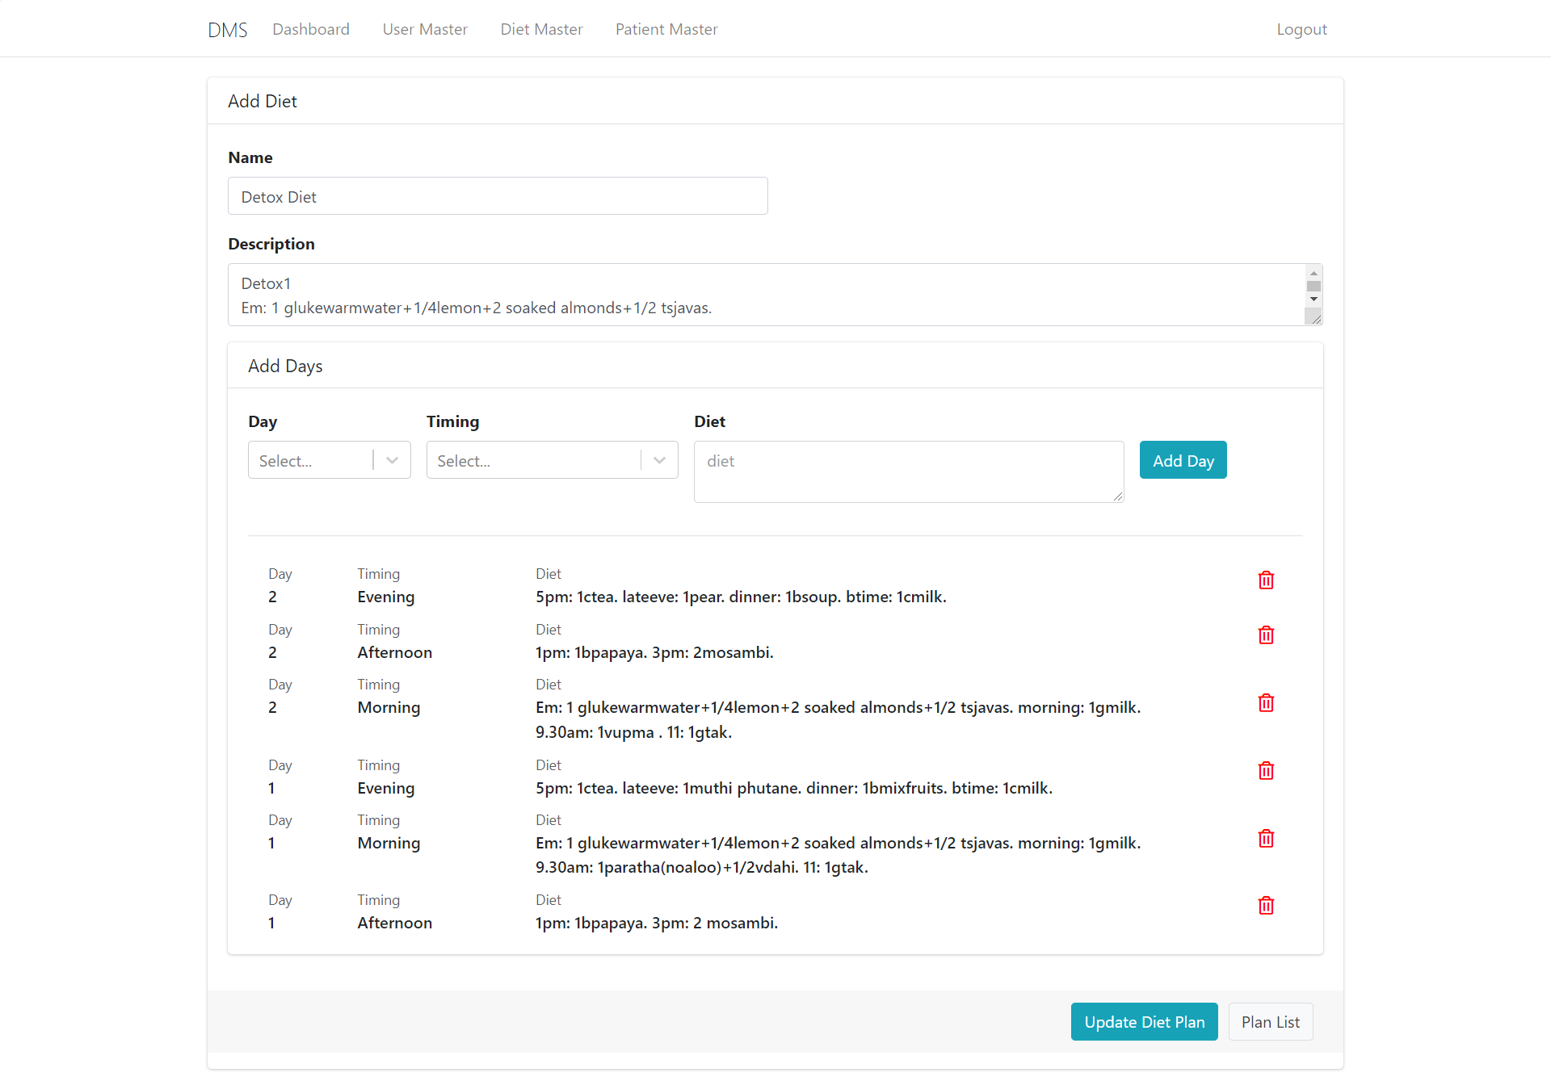
Edit Diet Plan in Admin login

Slide 34
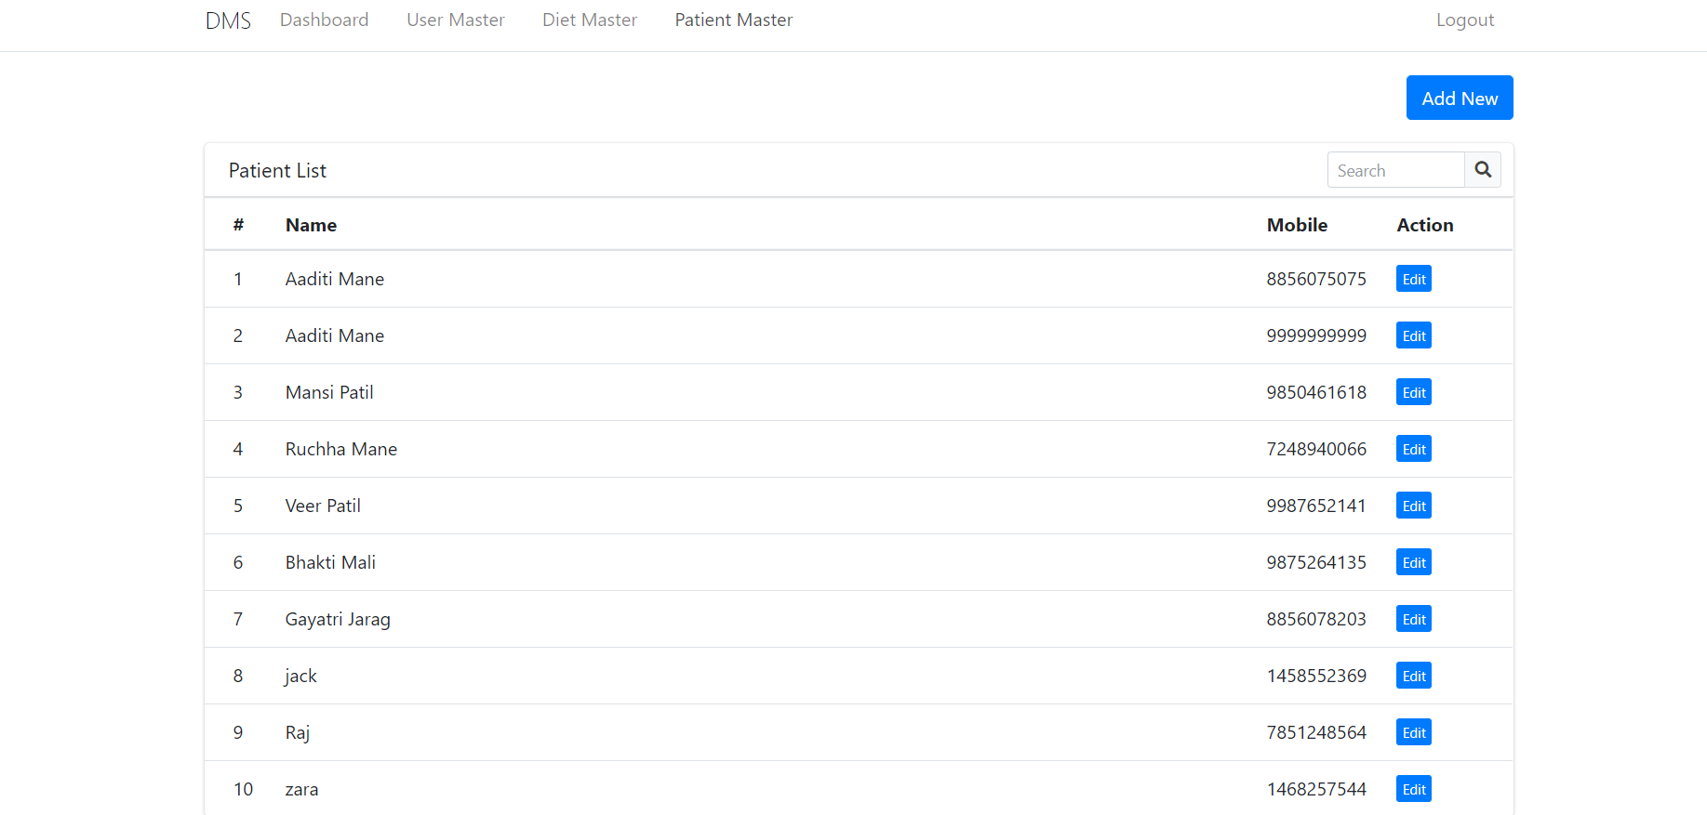
Patient List in Admin login

Slide 35
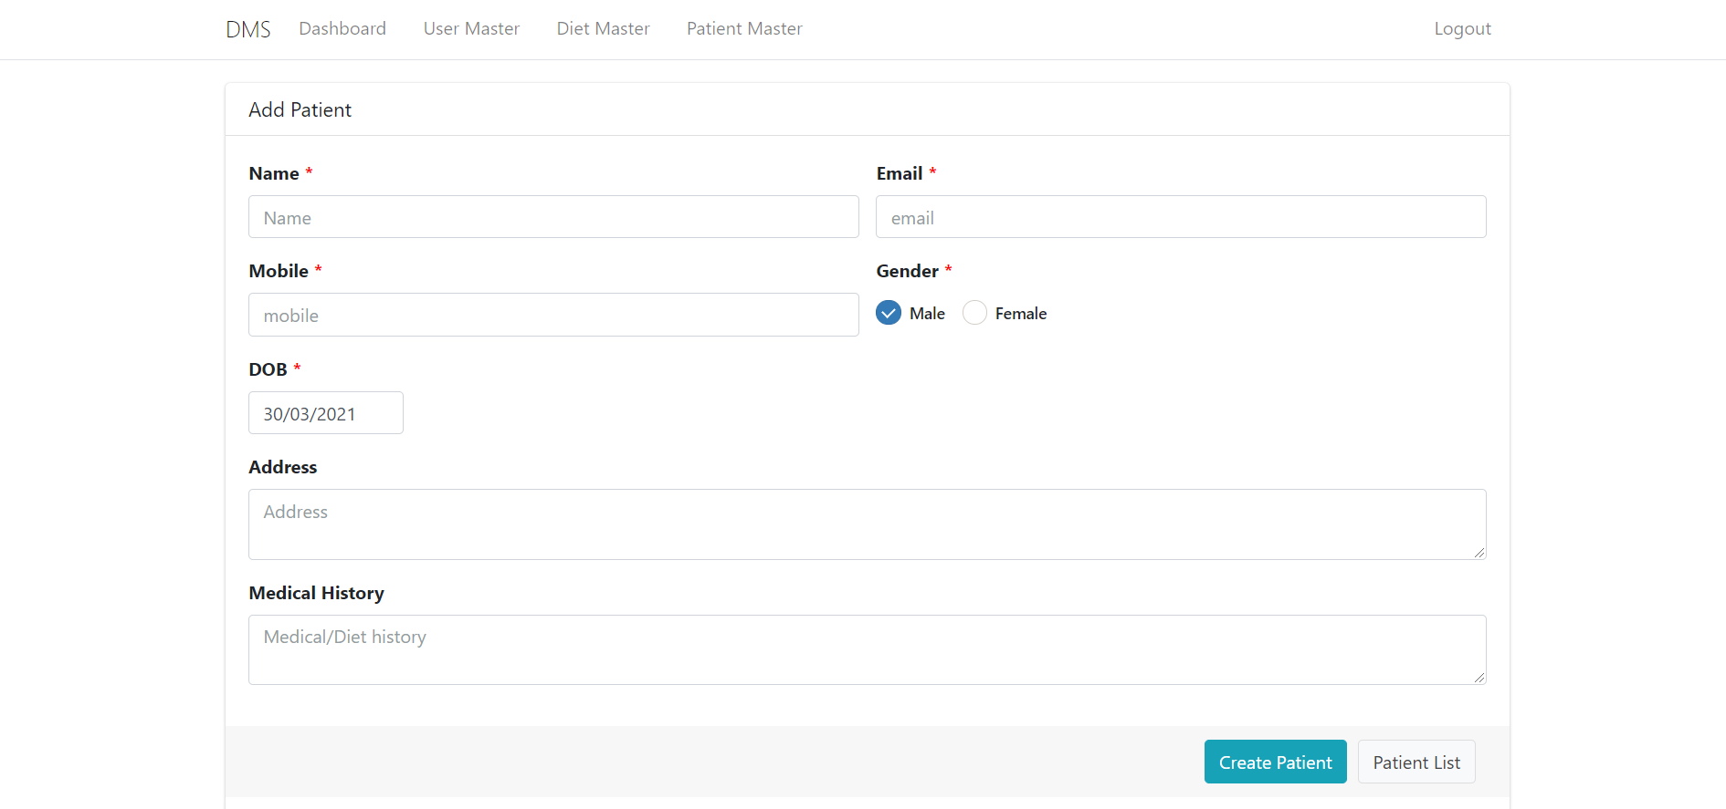
Create New Patient in Admin login

Slide 36
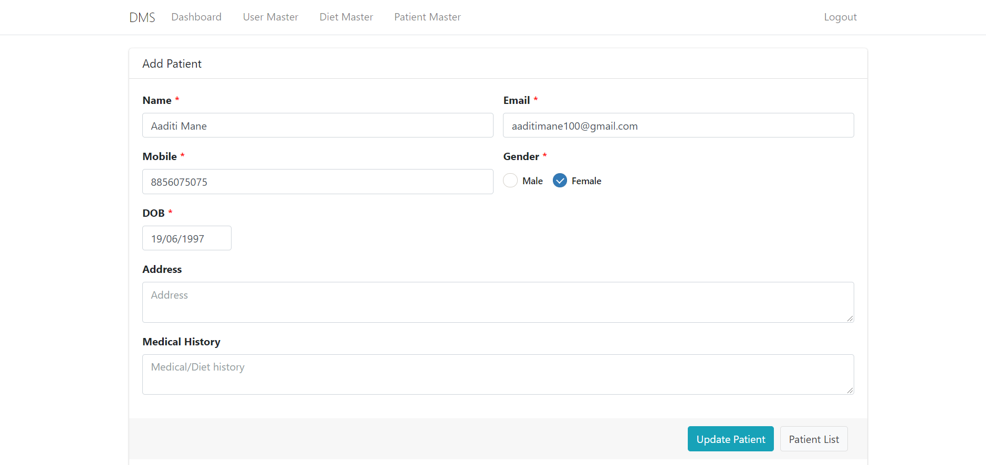
Edit Patient in Admin login

Slide 37
Conclusion
Our system provides all the requirements for managing the system and is capable to provide easy and effective storage of information related to the diet and patients.
The system can assist the doctor in planning a balanced diet with the information contained in the system and can be used easily and also provides the diet history tracking to make balanced food choices.
Our system has the potential capability of optimizing the time spent by dietitians to plan suitable menus and more quality time could be spent delivering nutrition education to the patients and maintaining and managing the data.

